Slide 1
자유자재로 데이터 가공하기

Slide 2
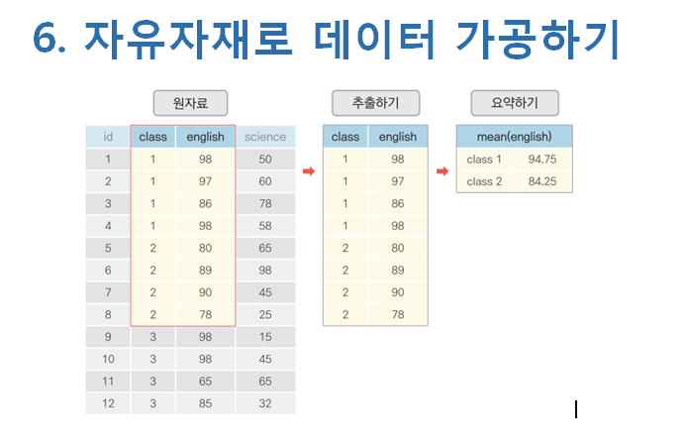

Slide 3
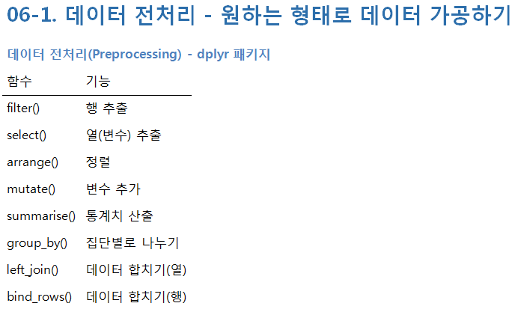

Slide 4
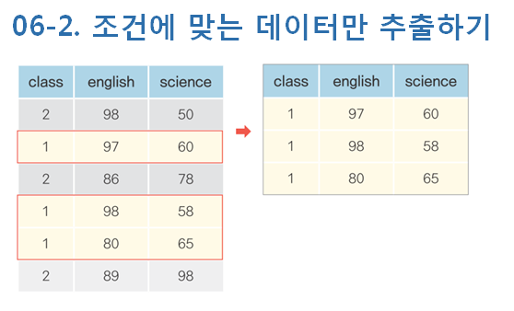

Slide 5
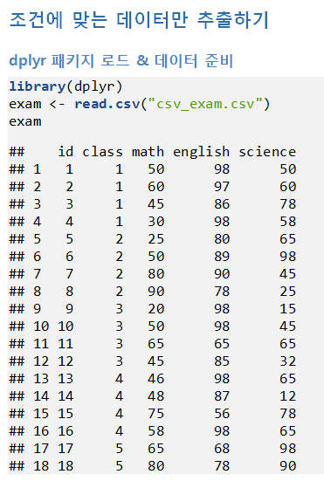

Slide 6
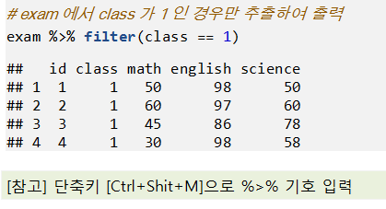
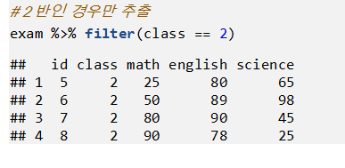

Slide 7
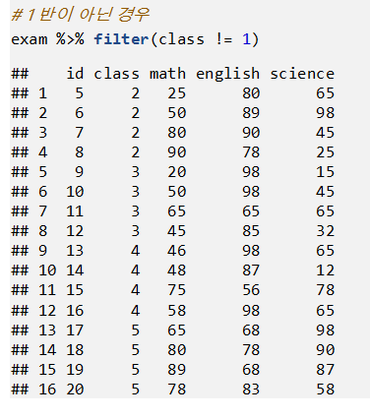

Slide 8
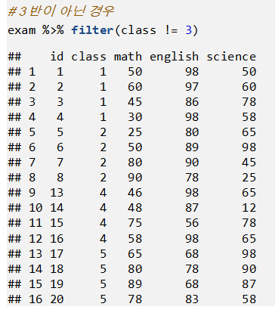

Slide 9
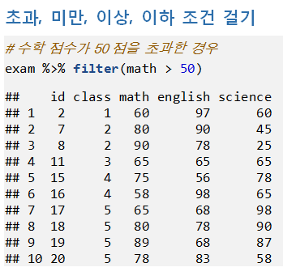
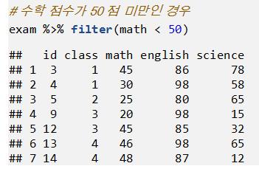

Slide 10
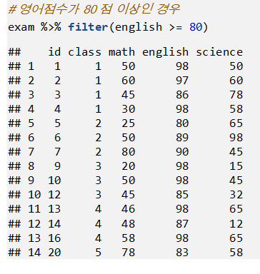
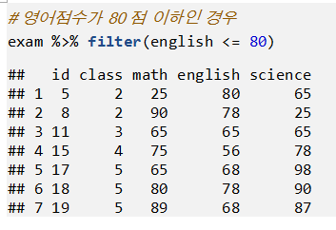

Slide 11
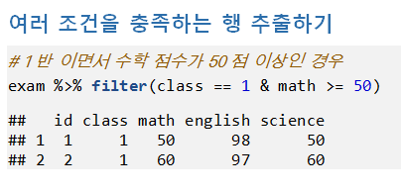
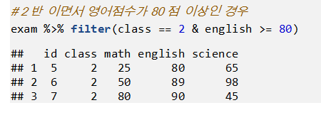

Slide 12
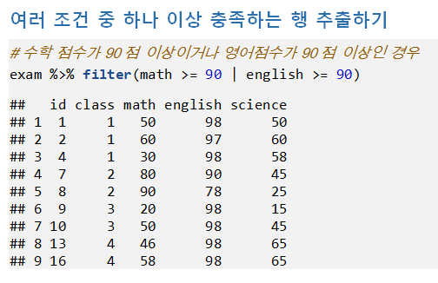

Slide 13
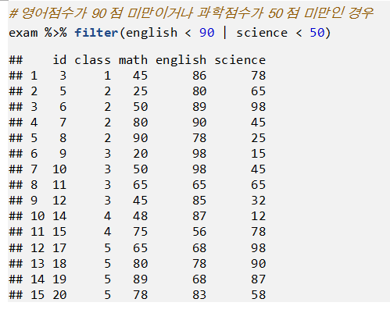

Slide 14
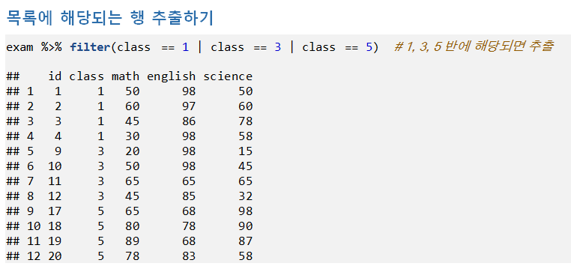

Slide 15
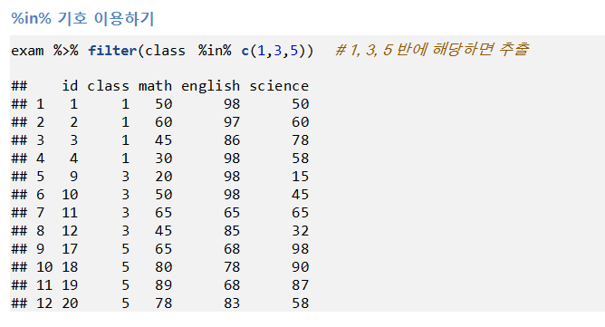

Slide 16
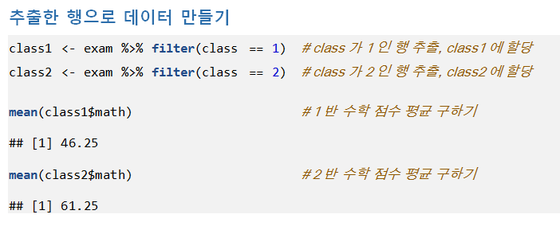

Slide 17
setwd("c:\\easy_r")
exam<-read.csv("csv_exam.csv")
exam
exam %>%filter(class==1)
exam %>%filter(class==2)
exam %>% filter(class!=1)
exam %>% filter(class!=3)
exam %>% filter(math>50)
exam %>% filter(math<50)
exam %>%filter(class==1 & math>=50)
exam %>%filter(class==1 & english>=80)
exam %>%filter(math>=90 | english>=90)
exam %>%filter(math<90 | english<50)
exam %>%filter(class==1|class==2|class==5)
exam %>%filter(class%in%c(1,3,5))
class1<-exam%>%filter(class==1)
class2<-exam %>% filter(class==2)
mean(class1$math)
mean(class2$math)

Slide 18
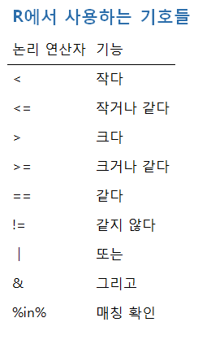
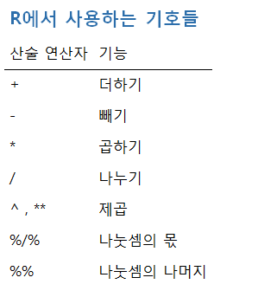

Slide 19
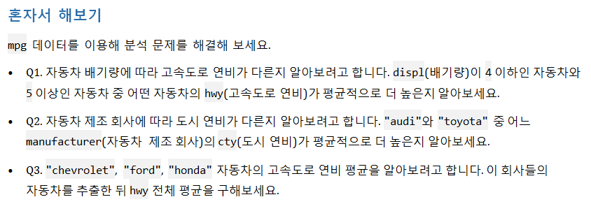
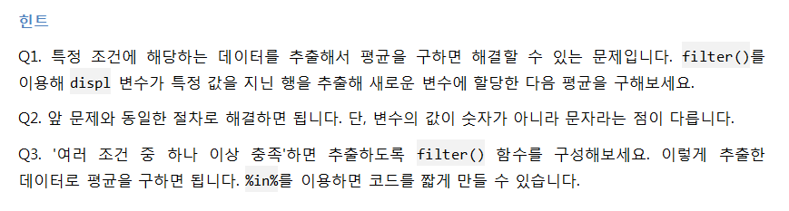

Slide 20
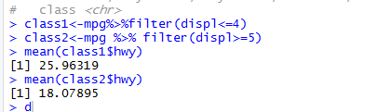
1번 문제
(ggplot2 library를 불러옴!!)
mpg<-as.data.frame(ggplot2::mpg)
mpg
class1<-mpg%>%filter(displ<=4)
class2<-mpg %>% filter(displ>=5)
mean(class1$hwy) ➔배기량이 4 이하인 자동차가 hwy 가 더 크다
mean(class2$hwy)

Slide 21
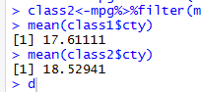
2번문제
class1<-mpg%>%filter(manufacturer=="audi")
class2<-mpg%>%filter(manufacturer=="toyota")
mean(class1$cty)
mean(class2$cty) →toyota가 도시연비가 평균적으로 더 높다

Slide 22
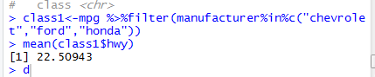
3번문제
class1<-mpg %>%filter(manufacturer%in%c("chevrolet","ford","honda"))
mean(class1$hwy)

Slide 23
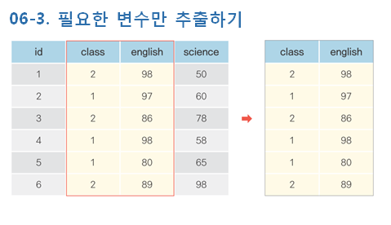

Slide 24
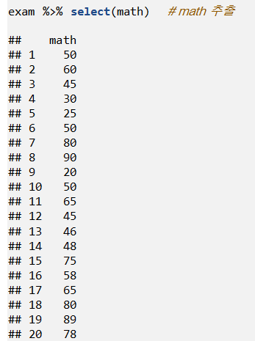
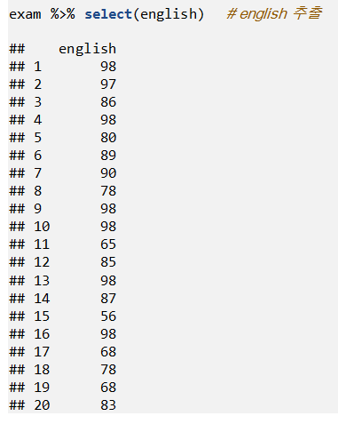

Slide 25
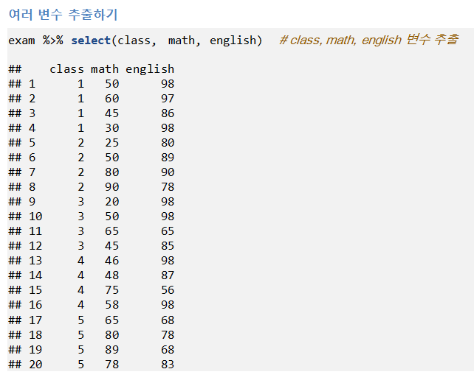

Slide 26
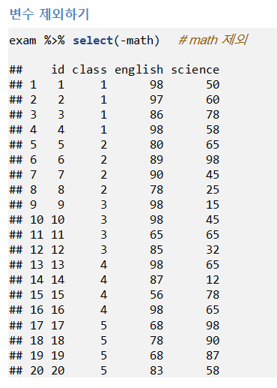
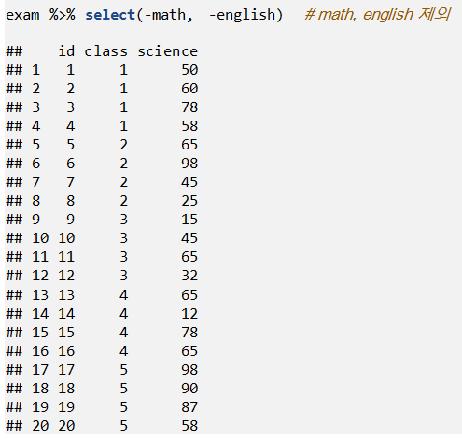

Slide 27
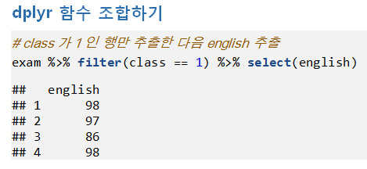
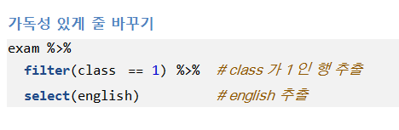

Slide 28
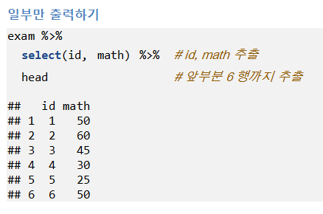
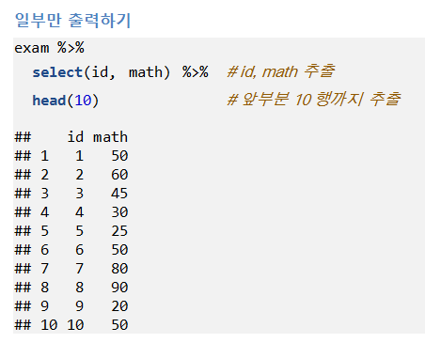

Slide 29
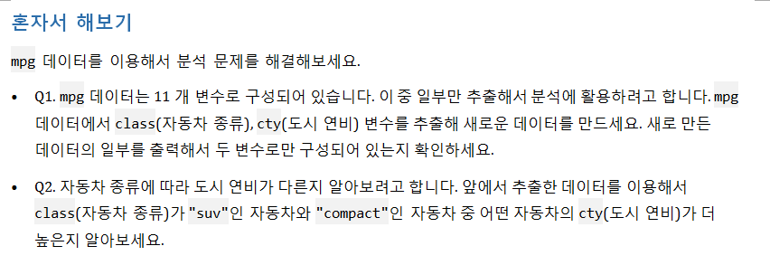
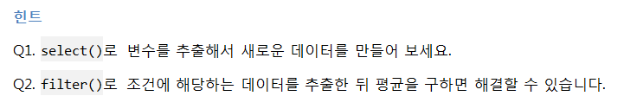

Slide 30
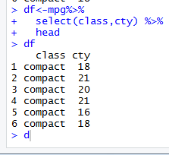
df<-mpg%>%
select(class,cty) %>%
head
df

Slide 31
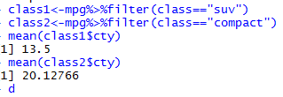
class1<-df%>%filter(class=="suv")
class2<-df%>%filter(class=="compact")
mean(class1$cty)
mean(class2$cty) →class 가 compact 인 자동차의 도시연비가 크다.

Slide 32
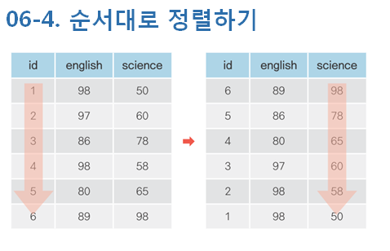

Slide 33
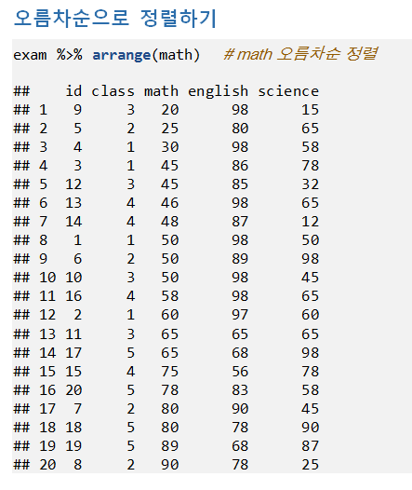
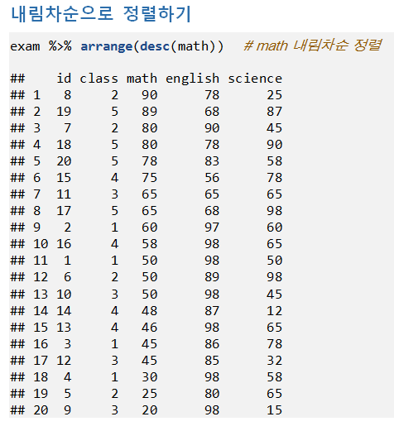

Slide 34
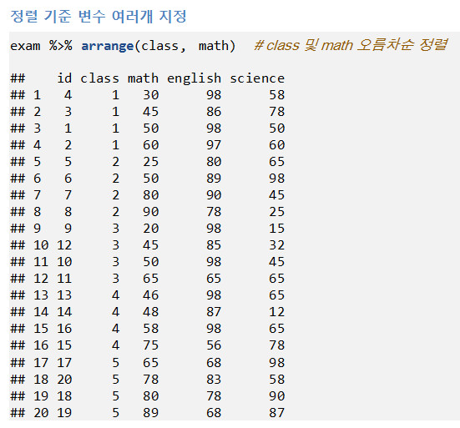

Slide 35
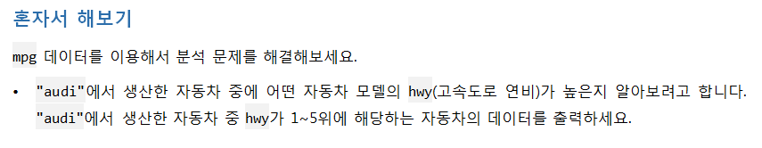
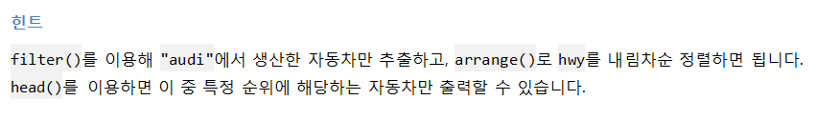

Slide 36
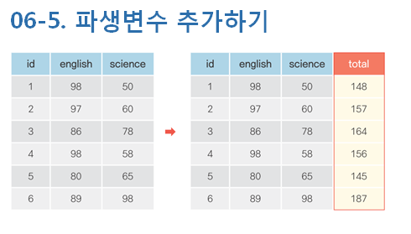
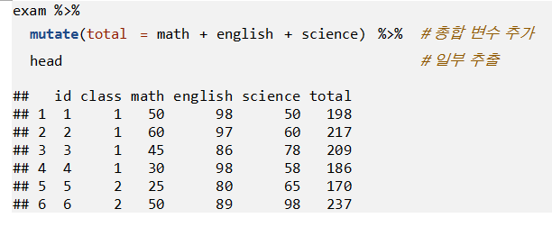

Slide 37
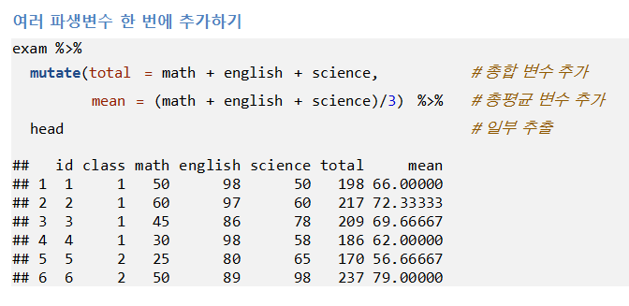
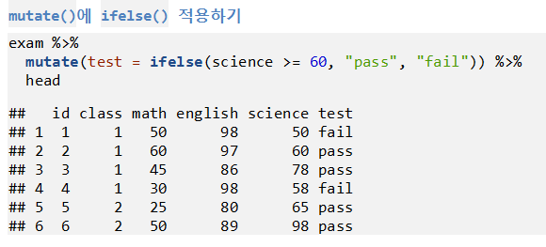

Slide 38


Slide 39



Slide 40

1번
mpg<-as.data.frame(ggplot2::mpg)
mpg_new<-mpg ->복사본 만들기
mpg_new<-mpg_new%>%mutate(total=hwy+cty)
2번
mpg_new<-mpg_new%>%mutate(mean=total/2)
3번
mpg_new%>%arrange(desc(mean)) %>%
head(3)
4번
mpg %>%
mutate(total=cty+hwy, mean=total/2) %>%
arrange(desc(mean)) %>%
head(3)

Slide 41


Slide 42


Notes:
exam %>%
summarise(mean_math=mean(math))
exam %>%
group_by(class) %>%
summarise(mean_math=mean(math))

Slide 43


Slide 44


Slide 45


Slide 46


Slide 47

mpg %>%
group_by(manufacturer) %>%
filter(class=="suv") %>%
mutate(tot=(cty+hwy)/2) %>%
summarise(mean_tot=mean(tot)) %>%
arrange(desc(mean_tot)) %>%
head(5)

Slide 48


Slide 49



Slide 50


1번
mpg %>%
group_by(class) %>%
summarise(mean_cty=mean(cty))
2번
mpg %>%
group_by(class) %>%
summarise(mean_cty=mean(cty))%>%
arrange(desc(mean_cty))

Slide 51

3번
mpg %>%
group_by(manufacturer) %>%
summarise(mean_hwy=mean(hwy))%>%
arrange(desc(mean_hwy)) %>%
head(3)
4번
mpg %>%
group_by(manufacturer) %>%
filter(class=="compact") %>%
summarise(n=n())%>%
arrange(desc(n))

Slide 52


Slide 53



Slide 54


Slide 55


Slide 56


Slide 57
test1<-data.frame(id=c(1,2,3,4,5),midterm=c(60,80,70,90,85))
test2<-data.frame(id=c(1,2,3,4,5),final=c(70,83,65,95,80))
total<-left_join(test1,test2,by="id")
total
name<-data.frame(class=c(1,2,3,4,5), teacher=c("kim","lee","park","choi","jung"))
name
exam_new<-left_join(exam,name,by="class")
exam_new

Slide 58



Slide 59


Slide 60



Slide 61


1번
fuel<-data.frame(fl=c("c","d","e","p","r"),price_fl=c(2.35,2.38,2.11,2.76,2.22),stringsAsFactors = F)
fuel
mpg<-left_join(mpg,fuel,by="fl")
mpg
2번
mpg%>%
select(model,fl,price_fl) %>%
head(5)

Slide 62


Slide 63


Slide 64


Slide 65


Slide 66


1번
midwest<-as.data.frame(ggplot2::midwest)
midwest
midwest %>%
mutate(poppercent=(poptotal-popadults)/poptotal*100)
2번
midwest %>%
mutate(poppercent=(poptotal-popadults)/poptotal*100) %>%
arrange(desc(poppercent)) %>%
select(county,poppercent) %>%
head(5)

Slide 67


3번
midwest
midwest<-midwest %>%
mutate(poppercent=(poptotal-popadults)/poptotal*100) %>%
mutate(grade=ifelse(poppercent>=40,"large",
ifelse(poppercent>=30,"middle","small")))
table(midwest$grade)
4번
midwest %>%
mutate(asianratio=(popasian/poptotal)*100) %>%
arrange(asianratio) %>%
select(state,county,asianratio) %>%
head(10)

